Slide 1

Can Reinforcement Learning Create a better Stock trader?
Robin Adair

Slide 2

Project Summary A methological Study of RL Stock market Trading programs
The programs take in stock data as input, with three options. Buy, Sell, or hold.
The aim was to maximize the maximum return over a series of time and compare the gains and training times in a methodological study between the algorithms using Tensorflow and PPO, A2C, DIJA, Ensemble methods.

Slide 3
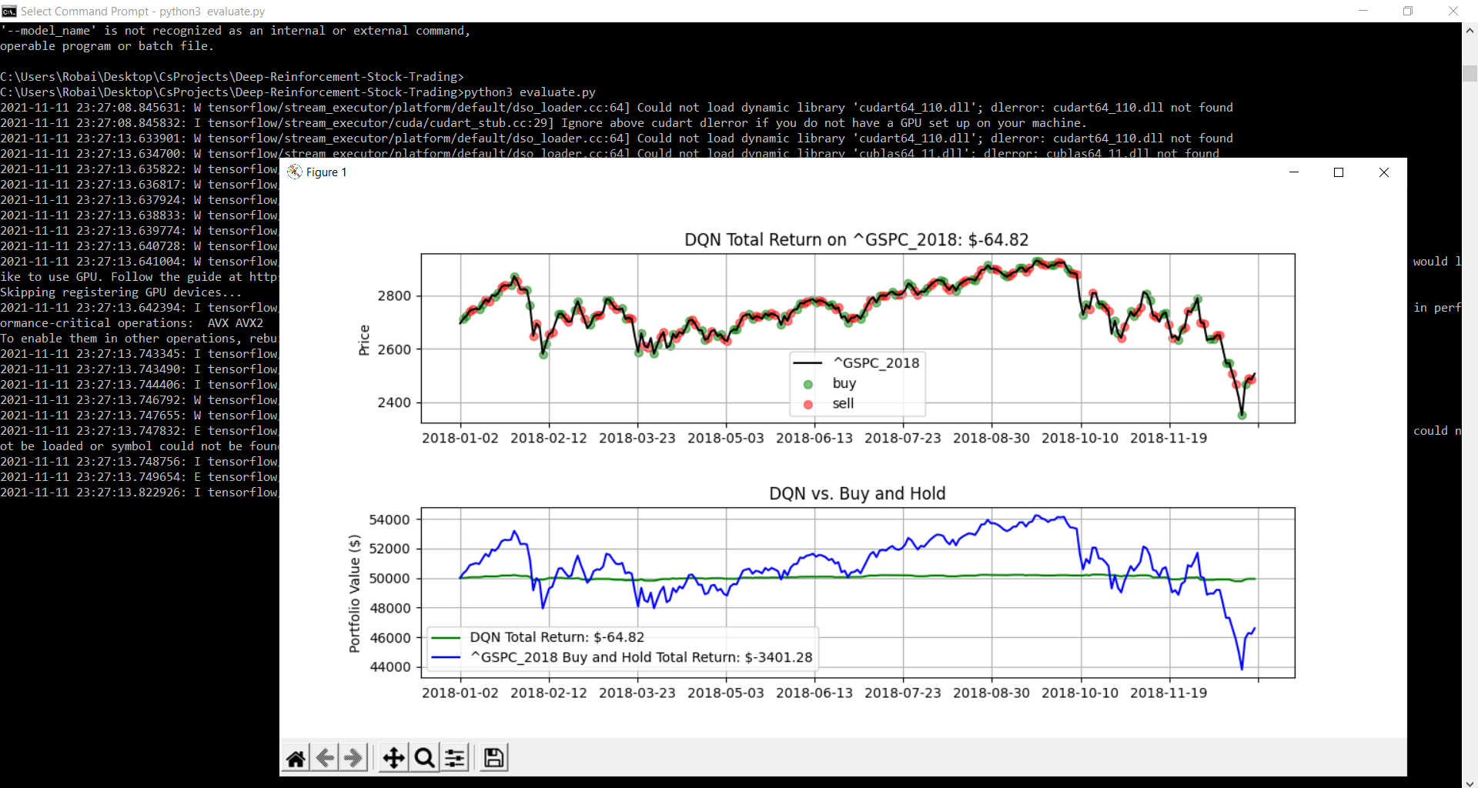
The first implementation baseline.
I started off wanting to compare a variety of approaches between algorithms. However, some algorithms trained on different circumstances produced wildly different results.
Such as this one model trained during a year when stock dropped in value, simply learned how to avoid losing value instead of gaining it.
The following on the left was the first baseline Implementation implemented, A DQN (Deep Q Network) agent.

Slide 4
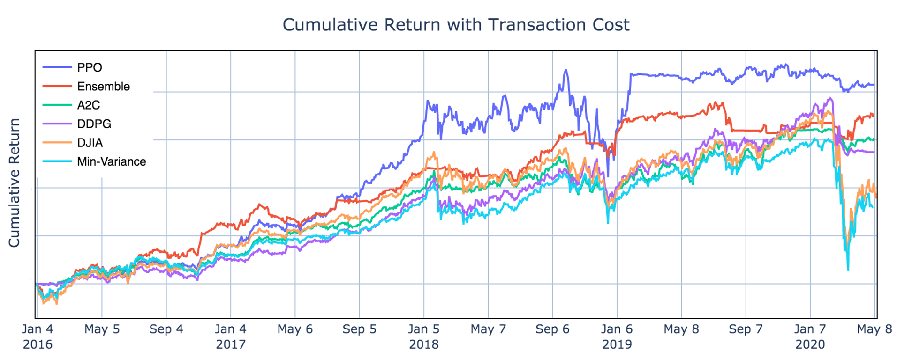
Can a AI beat the stock Market? Pt 2
For my next step I worked on adding the next baseline implementation to explore.
Supported Algorithms: PPO, Ensemble, A2C, DIJA methods
Training is done in 63, 1 week long epochs where the program is allowed to buy and sell.
Verification is then done in another set of 63 weekly epochs to evaluate data.
The final Verification process then evaluates the stocks over 4 years to verify itself.

Slide 6
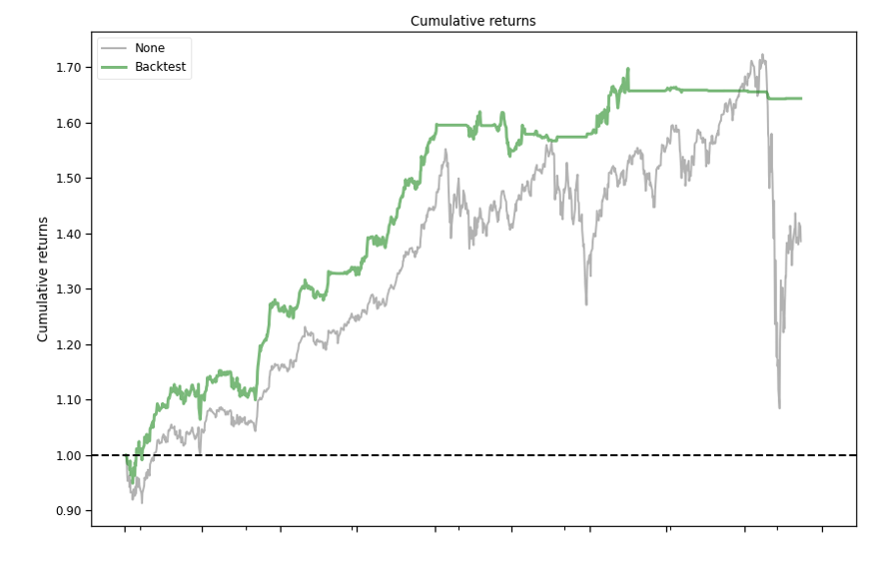
Testing the Ensemble Strategy
After collecting a variety of training data, it was time to go back and retest the ensemble strategy with a backtest.
I went back and corrected the baseline comparison with the new data as the previous was 10% higher than it should have been after further testing, obscuring the gains of the algorithms from showing up over the rl learning methods.
The programs were making a profit over the buy and hold baseline, but overshooting had hidden it.

Slide 7
Final Returns
Algorithm | Start to End Account Value | Increase in gain (vs +38% Baseline)
Buy and Hold Baseline | 1.0 M $ ->1.38 M $ (+38%) | 0% / (Baseline)
DDPG [1x training length, 25 minutes used] | 1.0 M $ -> 1.48 M $(+48%) | +10%
Ensemble [1x training length, 367 minutes] | 1.0 M $ -> 1.64 M $ (+64%) | +26%
PPO [1x training length, 140 minutes ] | 1.0M $ -> 1.78M (+78%) | +40%
PPO (2x Training length, 269 minutes used) | 1.0M $ -> 1.517 M (+51.7%) | +13.7%
DDPG[2x training length, 568 minutes used] | 1.0M $ -> 1.514 M (+51.4%) | +13.4%
Ensemble[2x training length, 3126 minutes] | 1.0M $ -> 1.49M (+49%) | +11%

Slide 8
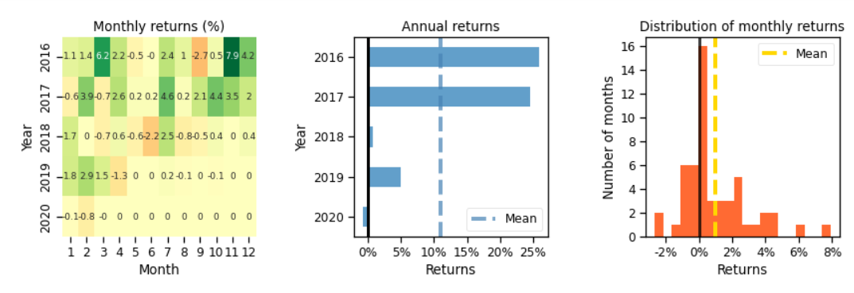
Monthly Return, Annual, and Distribution

Slide 9
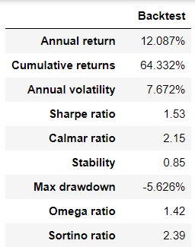
Data Analysis
We can see that the backtest is producing a average annual return of +12.087% a year, with cumulative returns at +64.332 (1.00 M $-> 1.64 M )
The annual volatility is analyzed in order to create the Sharpe ratio, (A financial performance metric to analyze investment risk. Above 1.00 is considered good, as we have here. Lower is considered risky/ heavily volatile.)

Slide 10
